Slide 1

AI Project
Group Endeavour

Slide 2
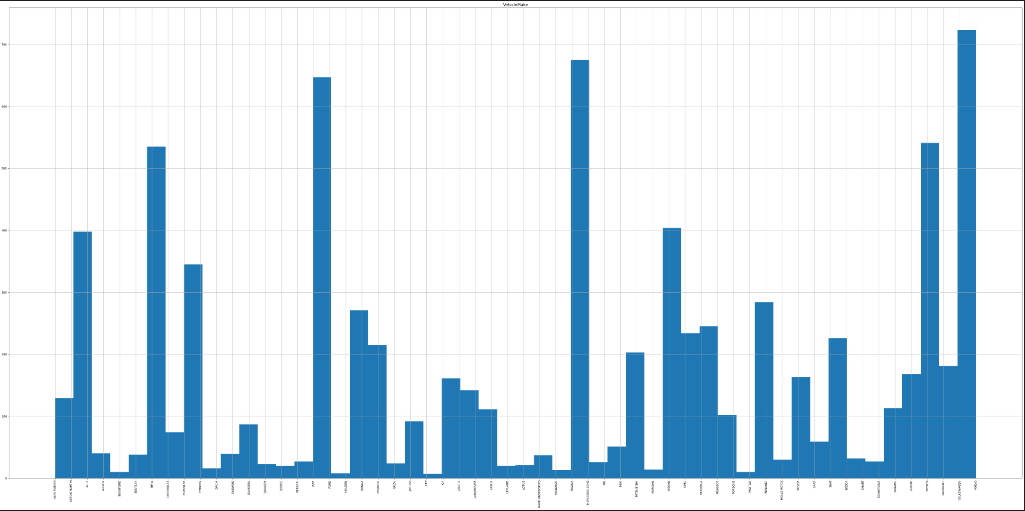
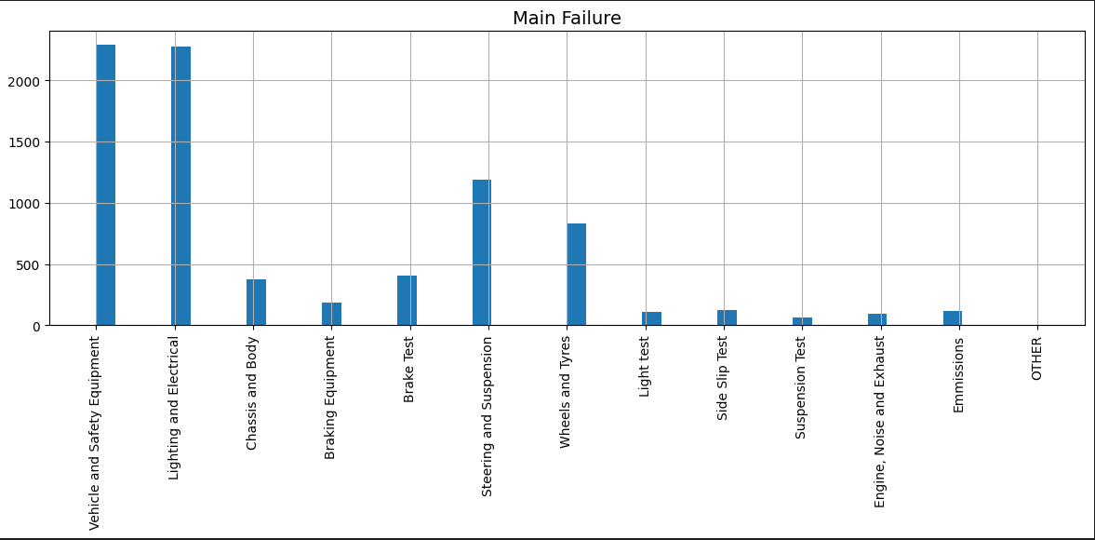
Introduction/Dataset Overview
Using Dataset from NCT on pass and failures with car models and brands.
Identify which car models are likely to fail in a specific part category.

Slide 3
The Business Problem
Who are we targeting?... buyers, car owners, brand owners, manufacturers etc.
Locate flaws of each car model.
Present those flaws to the specified parties.

Slide 4
Why is this important?
For Buyers...
Have awareness on the reliability of a specific car they want to purchase.
For Brand Owners, Manufacturers...
Reflect on the car's ability and flaws.

Slide 5
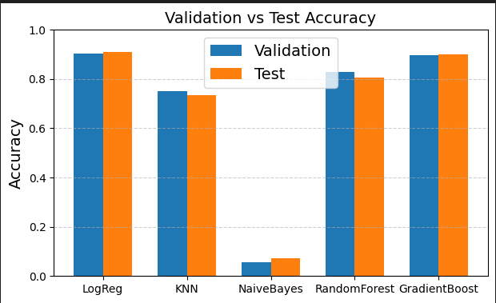
Model results

Slide 6
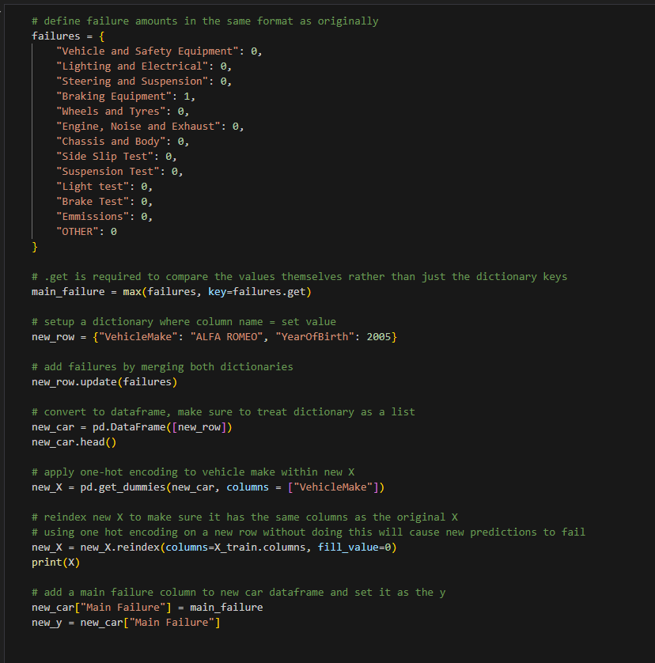
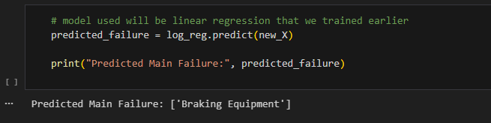
Demo
User inputs car make and year along with the failures.
Model will predict the main failure of the car.
Would be a better model if we had features of the car rather than failures.

Slide 7
Limitations Reflection
Users should be aware that the cars can have problems that aren't indicated by the data used.
Failures aren't enough to predict useful stuff alone.
Car models aren't all explicitly stated.
There could be bias with the brand distribution within Ireland.

Slide 8
Thank you for listening

